Slide 1
A Project on QUIZ GAME
Presented By:
Afifa Tasnim

Slide 2
QUIZ GAME Let’s check your brain storage
CONTENT
Introduction
Features
Output
Attachment

Slide 3
INTRODUCTION
This project gives a summary to our work for the game. It has a quiz part and it will increase a user knowledge.
This is a complete error-free Quiz Game Project in C designed as a simple console application. In this project a number of questions are asked.
In quiz game, questions are asked in such a way that they cover all field of a typical quiz contest. The users general knowledge is tested with quiz questions regarding ICT, Computer, Physics, Math and many more topics.

Slide 4
FEATURES (General Explanation)
There are 5 levels in the game.
Each level includes 10 questions.
For each correct answer user gets 1 score and aside at the end of the level bonus score is displayed according to obtained score.
A particular level can be played as long as a player wish.
Player can select level manually in the start menu and then levels up automatically only if the pre-set conditions are full-filled.

Slide 5
FEATURES (Used Conditions and Score Calculation)
For Level-Up
For Bonus Scores
For level-1 you have to score at-least 3 to proceed to the next level.
For level-2 this minimum score is 5.
For level-3 this minimum score is 7.
For level-4 this minimum score is 8.
For level-5 you have to score 10 out of 10.
Level-1 Bonus = Score*10
Level-2 Bonus1 = Bonus + Score*20
Level-3 Bonus2 = Bonus1 + Score*30
Level-4 Bonus3 = Bonus2 + Score*40
Level-5 Bonus4 = Bonus3 + Score*50

Slide 6
EXPECTED OUTCOME
Main menu display
Start option
Help
Exit option
User name authentication
Instructions
Option for selecting one among 5 levels
Main game
Display of score & bonus score
End game when user completes level 5

Slide 7
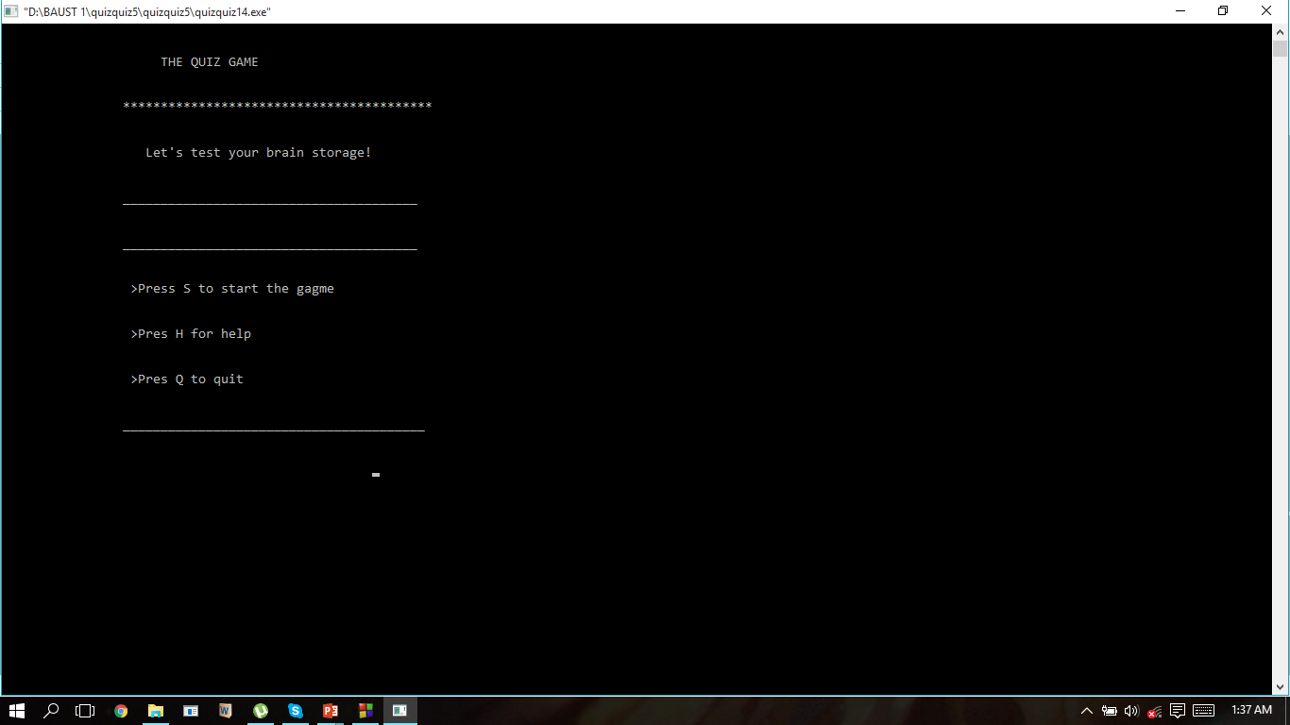
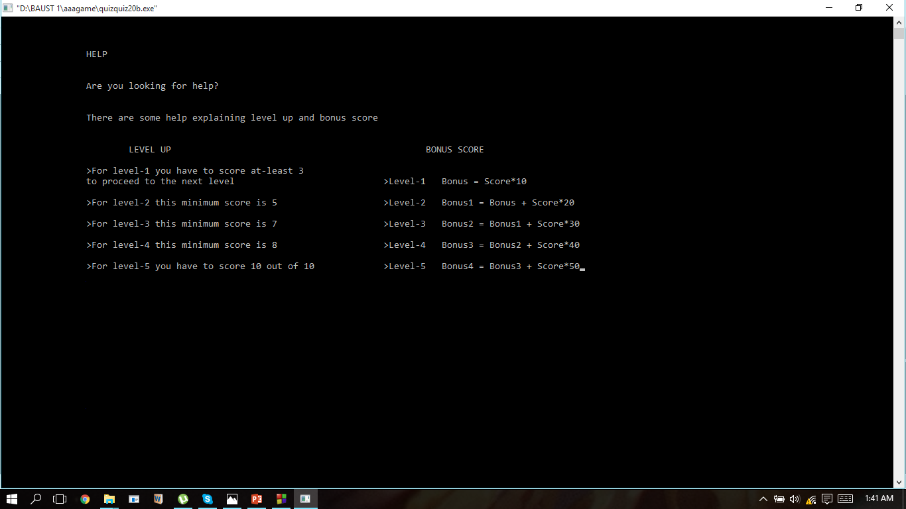

Slide 8
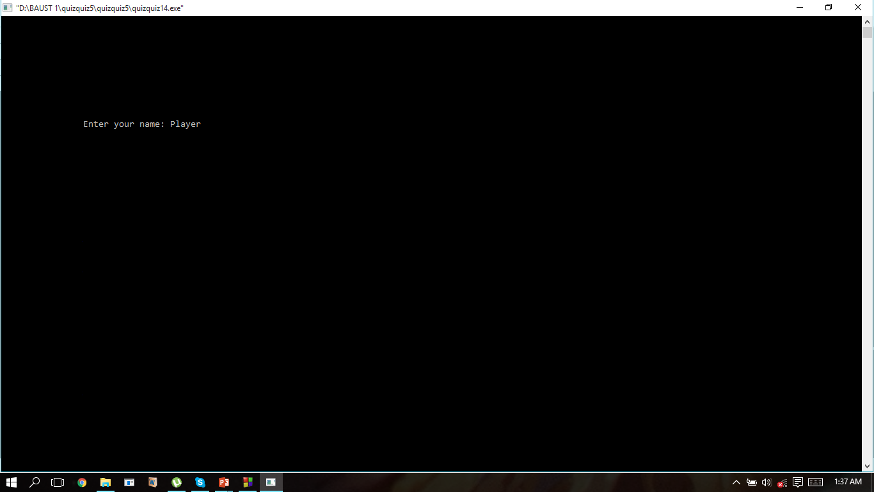
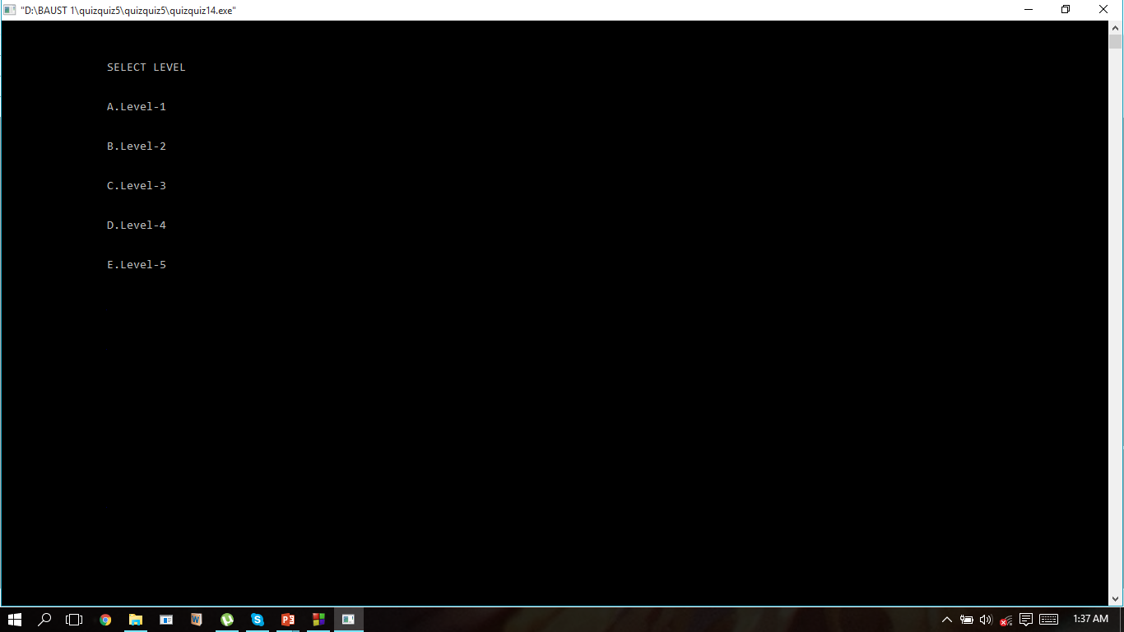
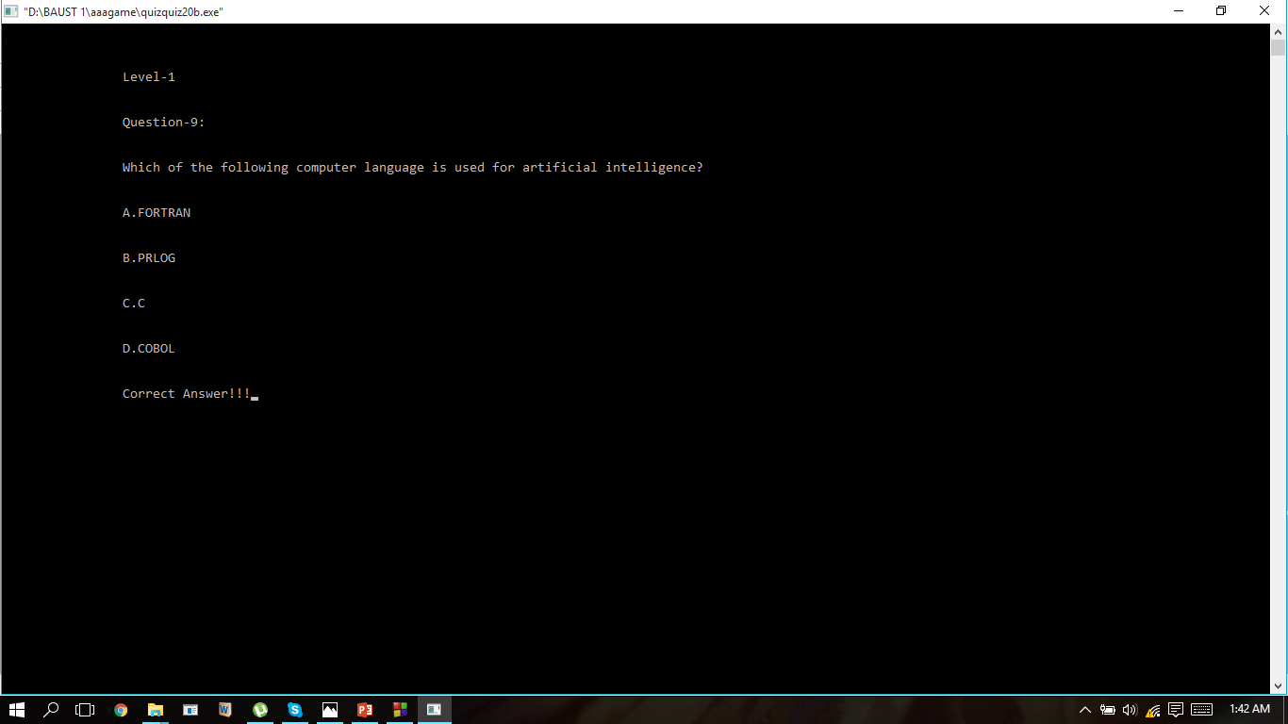
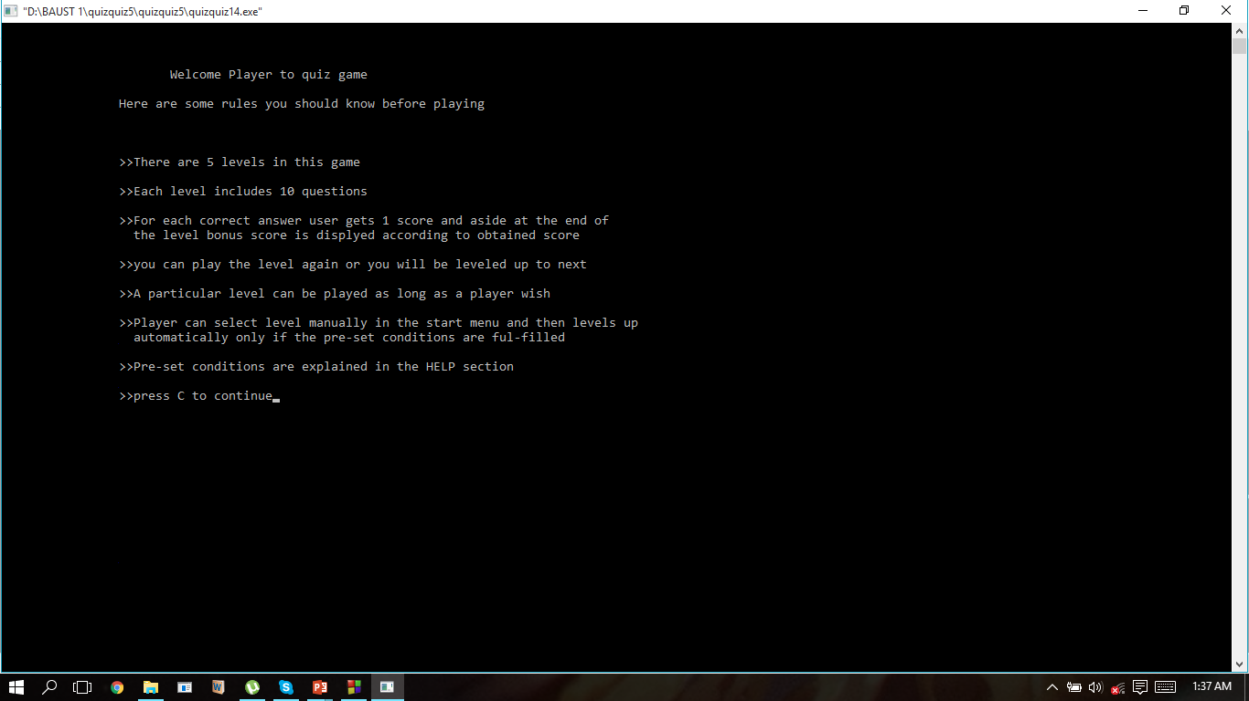

Slide 9
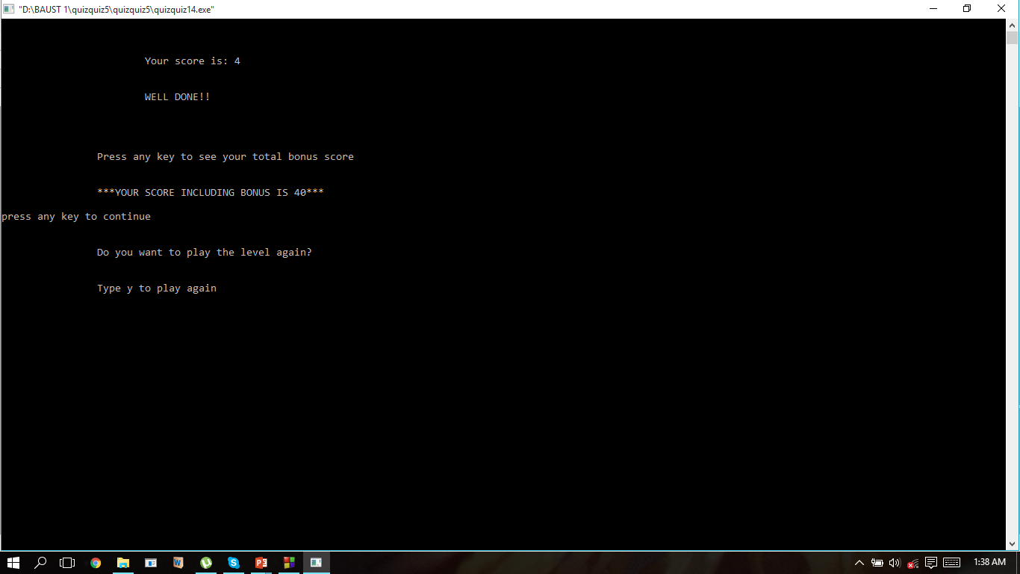
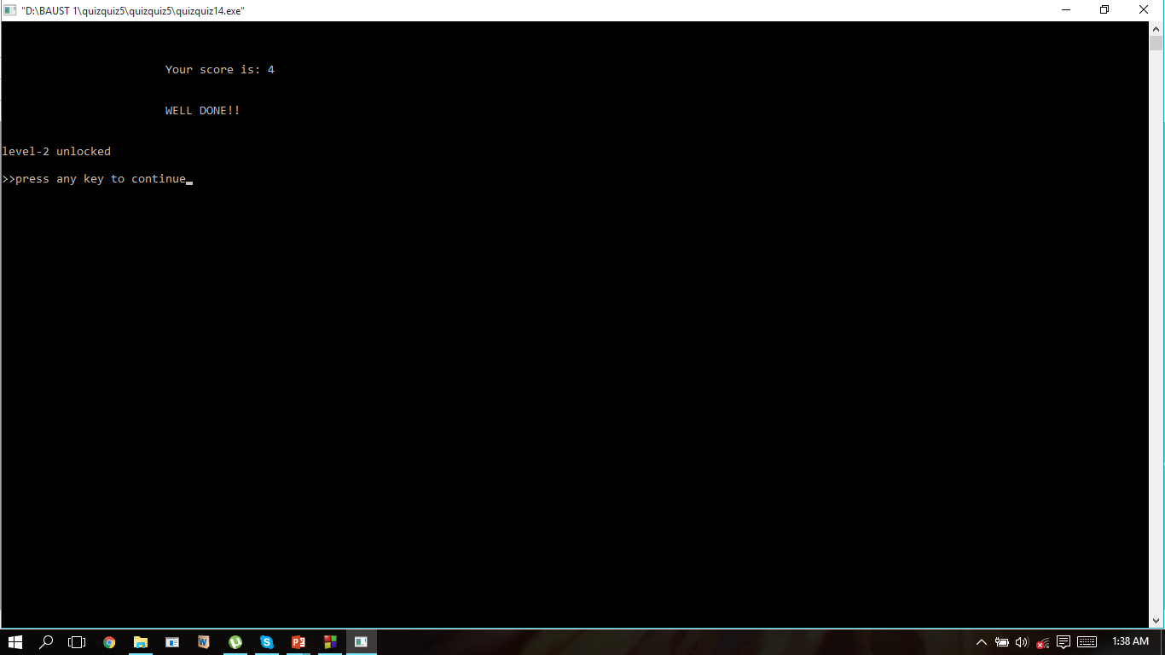
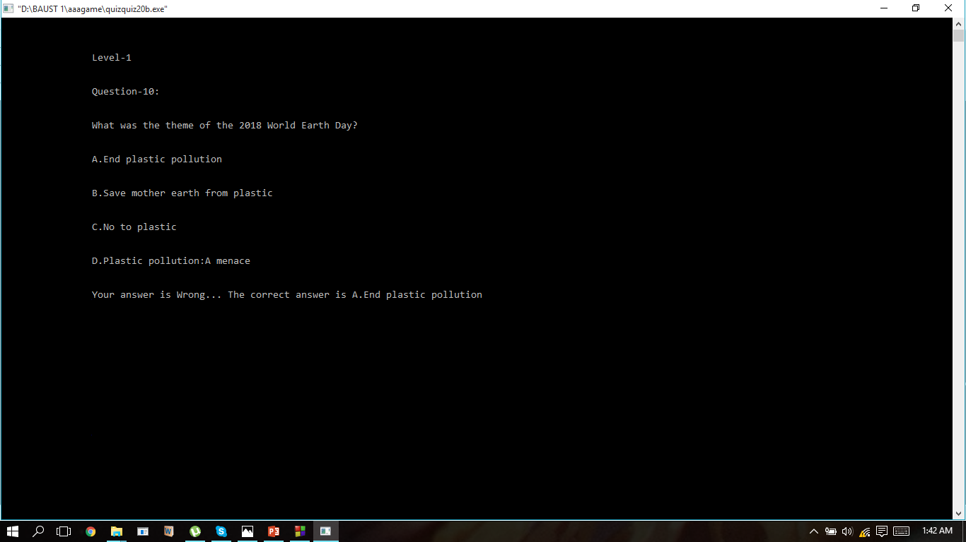
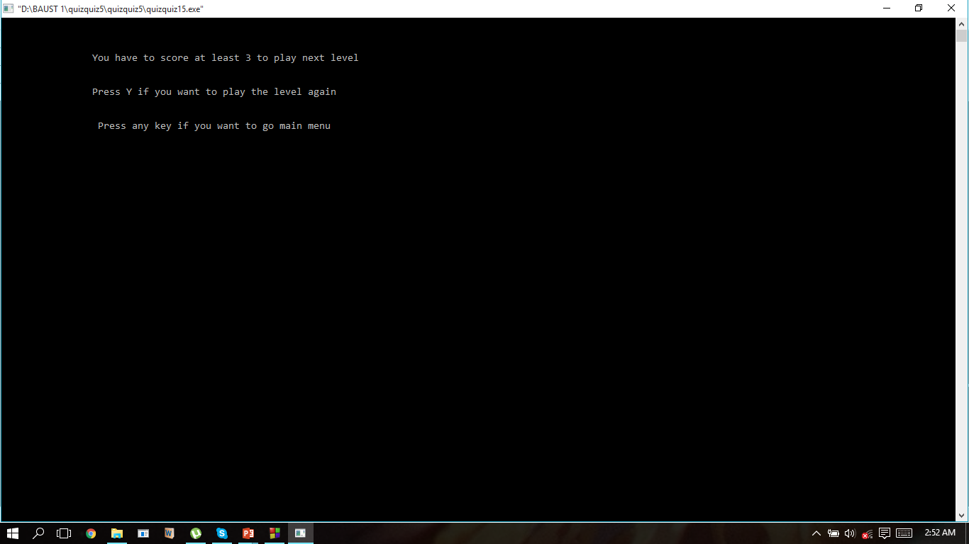

Slide 10
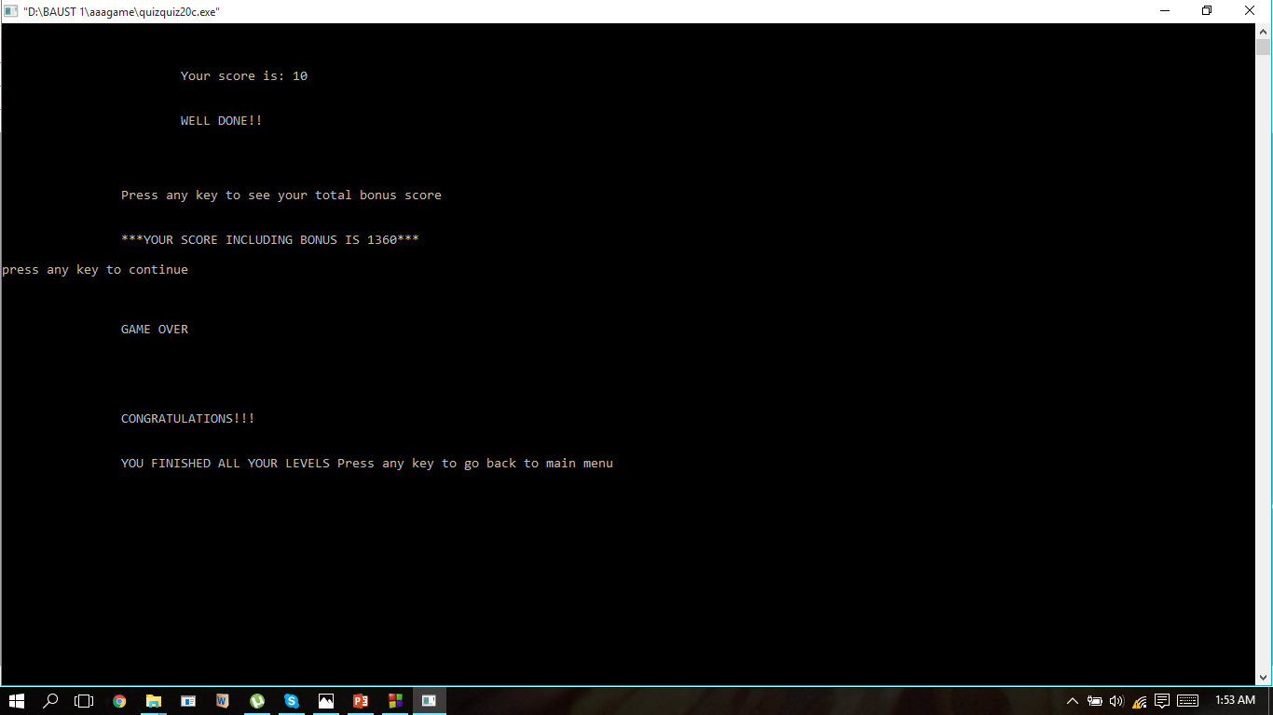

Slide 11

Thank You

